Slide 1
2020 Support Grants
Webinar
Presenters
Katherine Stevens, Director of Grants at Mass Humanities
Jennifer Hall-Witt, Program Officer at Mass Humanities
Still have questions? Email grants@masshumanities.org

Slide 2
Applying for 2020 Support Grants
1. Key Application Questions
Community Served + Mission and Work
Humanities Component + Program Description
Use of Funds
Q&A
2. The Application Process
Online System
Documents and Numbers
Q&A

Slide 3
Community Served and Organization Mission
Q: Select the description(s) that best match the community your organization supports with the majority of its resources. Select all that apply.
Indigenous communities
Communities of color
Low-income communities
Communities in poverty
Immigrants and/or Refugees
People who are or have been incarcerated
People who are homeless
People living with addiction
People living with mental illness
People living with disabilities
LGBTQ+ communities
Other - please identify below and explain the special risks the community faces.
Q: Organization Mission and Work Enter your organization’s mission statement and provide an overview of the range of things your organization does. Explain why you made the selection above for "community served."

Slide 4
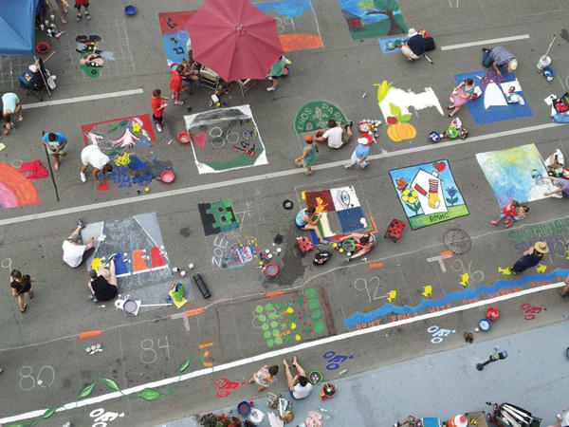
Sample Applicants
“East Africa Cultural Coalition”
“Springfield Community Arts”

Slide 5
Community Served and Organization Mission
Q: Select the description(s) that best match the community your organization supports with the majority of its resources. Select all that apply.
Indigenous communities
Communities of color
Low-income communities
Communities in poverty
Immigrants and/or Refugees
People who are or have been incarcerated
People who are homeless
People living with addiction
People living with mental illness
People living with disabilities
LGBTQ+ communities
Other - please identify below and explain the special risks the community faces.
“East Africa Cultural Coalition”

Slide 6
Community Served and Organization Mission
Q: “Enter your organization’s mission statement and provide an overview of the range of things your organization does. Explain why you made the selection above.”

Slide 7
Community Served and Organization Mission
A: “East Africa Cultural Coalition’s mission is to empower community members to become active residents of Massachusetts through social services, education programs, and cultural heritage celebrations. Our organization helps recent immigrants from East Africa find stable jobs and housing, provides community mentors to help newly arrived parents and children work with the local schools, hosts citizenship classes, and coordinates our annual 3-day cultural heritage festival. We chose the four descriptions for “community served” because our community is made up of recent refugees from East Africa, as well as immigrants who have lived in Massachusetts for over three decades. We work in the city of Worcester and the surrounding county, where approximately 600 residents are from East Africa. While many do find jobs and start businesses, our community still experiences significantly lower income levels than other communities in our city. 50% of the members of our community experience poverty at some point in their lives here.”

Slide 8
Community Served and Organization Mission
Q: “Enter your organization’s mission statement and provide an overview of the range of things your organization does…”
A: “East Africa Cultural Coalition’s mission is to empower community members to become active residents of Massachusetts through social services, education programs, and cultural heritage celebrations. Our organization helps recent immigrants from East Africa find stable jobs and housing, provides community mentors to help newly arrived parents and children work with the local schools, hosts citizenship classes, and coordinates our annual 3-day cultural heritage festival. We chose the four descriptions for “community served” because our community is made up of recent refugees from East Africa, as well as immigrants who have lived in Massachusetts for over three decades. We work in the city of Worcester and the surrounding county, where approximately 600 residents are from East Africa. While many do find jobs and start businesses, our community still experiences significantly lower income levels than other communities in our city. 50% of the members of our community experience poverty at some point in their lives here.”

Slide 9
Community Served and Organization Mission
Q: Explain why you made the selection above.”
A: “East Africa Cultural Coalition’s mission is to empower community members to become active residents of Massachusetts through social services, education programs, and cultural heritage celebrations. Our organizations helps recent immigrants from East Africa find stable jobs and housing, provides community mentors to help newly arrived parents and children work with the local schools, hosts citizenship classes, and coordinates our annual 3-day cultural heritage festival. We chose the four descriptions for “community served” because our community is made up of recent refugees from East Africa, as well as immigrants who have lived in Massachusetts for over three decades. We work in the city of Worcester and the surrounding county, where approximately 600 residents are from East Africa. While many do find jobs and start businesses, our community still experiences significantly lower income levels than other communities in our city. 50% of the members of our community experience poverty at some point in their lives here.”

Slide 10
Audience Questions

Slide 11
Humanities Component and Program Description
Q: Select the description(s) that best match the humanities activities in your program.
Community storytelling and conversation
Passing down culture and traditions
Conversations about values, identities, and big questions about the world we live in
Education or conversation about books, theater, music, art, media, or history
Education or conversation about community issues and government
Education about citizenship and democracy
Literacy education for adults
Any of the above as specific part of creating some other kind of event like a play or art project.
Other - please describe below in the “programs that engage the humanities” section.
Q: Of the program(s) run by your organization in the past 2 years, describe the ones that engage the humanities. In this section, focus on describing all of the following: how your program(s) fits the selection(s) you made above, what participants in the program(s) do, who participates in the program(s), how many participants there are (on average), and how often the program(s) engages participants over the course of a year.

Slide 12
Humanities Component
Q: Select the description(s) that best match the humanities activities in your program.
Community storytelling and conversation
Passing down culture and traditions
Conversations about values, identities, and big questions about the world we live in
Education or conversation about books, theater, music, art, media, or history
Education or conversation about community issues and government
Education about citizenship and democracy
Literacy education for adults
Any of the above as specific part of creating some other kind of event like a play or art project.
Other - please describe below in the “programs that engage the humanities” section.

Slide 13
Program Description
Question: Of the program(s) run by your organization in the past 2 years, describe the ones that engage the humanities. In this section, focus on describing all of the following:
How your program(s) fits the selection(s) you made above
What participants in the program(s) do
Who participates in the program(s)
How many participants there are (on average)
How often the program(s) engages participants over the course of a year

Slide 14
Program Description
A: “Education about citizenship and democracy”: Since 2017 we have provided citizenship classes. They take place over the course of three months, meeting twice a week for an hour. Classes are free and usually have 10-15 adult students from the East African communities in our city. We try to hold two series of classes each year. Students in the class prepare for the citizenship exam. They learn and also have conversations about key test information. For example, students not only learn the national holidays, at the end of the class they propose a new holiday based on American history. They then explain how they would convince their Representatives to support it. When we learn about the Bill of Rights, students discuss which rights matter most to them and find an example of that right in their daily lives.

Slide 15
Program Description
A: “Passing down culture and traditions” From spring to summer we plan and prepare for our festival, which takes place over three days in July. In addition to the festival days, from March-June young people, ages 4-15, take classes to learn traditional music and that music’s history. They then perform at the festival. We usually have 8-10 students with each of our three master teachers. They meet once a month at first and then weekly in June before the festival. While we could not hold the festival this summer, we were able to continue the classes for some of our students over the internet. Classes are free for students. The festival is free for people to attend. Local restaurant sand shop owners pay for vendor spaces at the event. Last year 400 people attended.

Slide 16
Humanities Component
Q: Select the description(s) that best match the humanities activities in your program.
Community storytelling and conversation
Passing down culture and traditions
Conversations about values, identities, and big questions about the world we live in
Education or conversation about books, theater, music, art, media, or history
Education or conversation about community issues and government
Education about citizenship and democracy
Literacy education for adults
Any of the above as specific part of creating some other kind of event like a play or art project.
Other - please describe below in the “programs that engage the humanities” section.
Springfield Community Arts

Slide 17
Program Description
Springfield Community Arts
Q: Of the program(s) run by your organization in the past 2 years, describe the ones that engage the humanities. In this section, focus on describing all of the following: how your program(s) fits the selection(s) you made above, what participants in the program(s) do, who participates in the program(s), how many participants there are (on average), and how often the program(s) engages participants over the course of a year.

Slide 18
Program Description
A: Our museum designs educational programming in response to our exhibits. For our recent exhibit showcasing black and white photographs of the Bhutanese community in Springfield, we hosted a panel with leaders from the Bhutanese community discussing the history of Bhutanese migration to Nepal and then to the U.S. as well as a local psychologist discussing the mental and emotional challenges of migration. The audience had around 100 people, with about two-thirds from the local Bhutanese community, and fostered a wide-ranging conversation. Another event was a screening and discussion of a documentary on Bhutanese immigrants to the U.S. by Binod Paudel. The audience was students from a local high school with a large Bhutanese immigrant population who took a half-day field trip to our museum. The discussion compared how identities get represented in documentary film vs. documentary photography. Students broke up into groups and take short videos and photographs of each other with their phones and then compare them. We do events such as these about once every six weeks, in addition to our weekly gallery talks where we engage visitors in conversation about the art they see using open-ended questions that invite them to connect the art with their own lives.

Slide 19
Audience Questions

Slide 20
Use of Funds
Q: Question: How do you plan to use the funds if you are awarded a grant? What you say here can be revised later as your needs change.
Funding is for operating support, which can include the programming costs.
You do not have to use the funding for your humanities programs.
Your answer does not affect the funding decision.
We ask this question because we want to make sure you are imagining spending the funds on allowable expenses. If not and you are awarded a grant, we will let you know after you have been notified of your award.

Slide 21
Use of Funds
Funds are to be used only for operating expenses, which can include expenses for programming.
Funds may NOT be used for any of the following:
Promotion of a particular political, religious, or ideological point of view
Advocacy of a particular program of social or political action
Support for specific public policies or legislation
Lobbying
Purchase of land or facilities, or the cost of construction or renovation
Debt or deficit reduction
Endowment of capital campaigns
For research or feasibility studies

Slide 22
Use of Funds
We will use our funds to:
Buy 2 laptops and hotspots to loan to families in our cultural heritage classes during the pandemic ($2000).
Rent on our space ($1900)
Salaries for office staff who are coordinating our service programs ($1100).

Slide 23
Use of Funds
We will use our funds for:
Rent on our gallery space ($3000).
Supplies for a mural project in partnership with the NAACP of Springfield ($600).
Salary for our part-time education coordinator ($1400).

Slide 24
Audience Questions

Slide 25
Applying for 2020 Support Grants

Slide 26
Gather Your Materials – Creating an Account
Your organization’s Tax ID Number (Employer Identification Number)
A 9-digit number that the IRS uses to identify business in the U.S. and Territories. Ex: 12-3456789
Your organization’s mailing address.
Application Contact Person email and mailing address

Slide 27
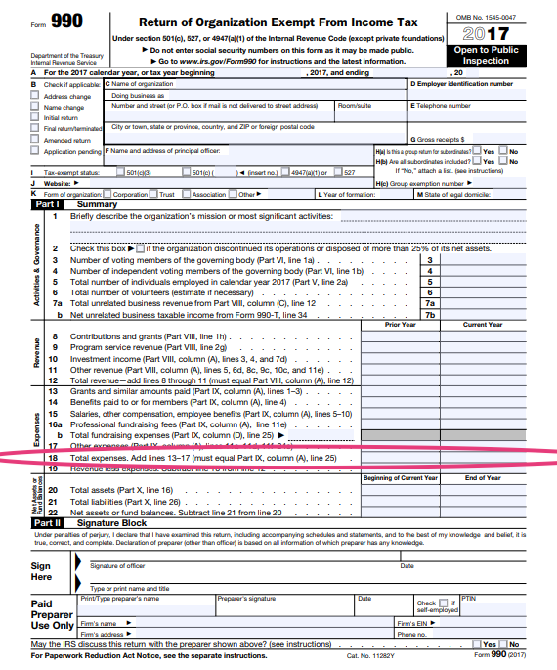
Gather Your Materials – Financial Information
501(c)3 Organizations
Your most recently filed 990
Total Operating Expenses = current year, line 18 (990) or line 17 (990 EZ)

Slide 28
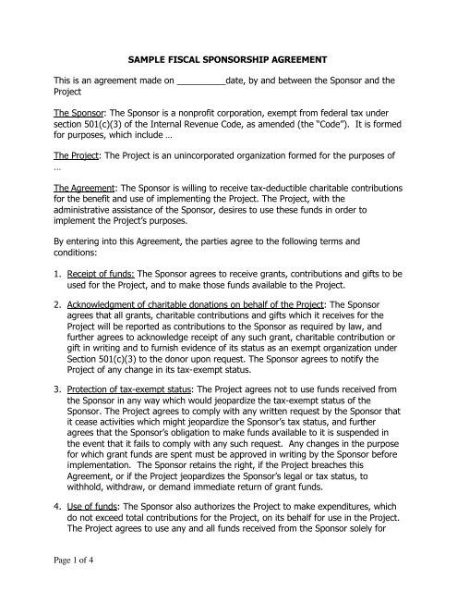
Gather Your Materials – Financial Information
Non-501(c)3 non-profits
Your fiscal sponsor agreement
Your fiscal sponsor’s legal name
Your fiscal sponsor’s mailing address
Your fiscal sponsor’s Tax ID Number
Your organization’s budget (showing total expenses for 2019).

Slide 29
Start Your Application

Slide 30
Audience Questions

